Slide 1
What is a BUG ?

Slide 2

What is a bug ?
Software doesn’t work properly
Cause of catastrophic results and loss of life.
Software failure.
Defect
Fault
Incident
Problem
Error

Slide 3
Some definitions
Error – a mistake in design, coding, requirements, even testing
Fault – the representation of the error
Failure – what happens when the fault “executes”
Incident – the user-visible manifestation of the failure

Slide 4
What is a bug ?
Software bug is an error, flaw, mistake, failure, or fault in a computer program that prevents it from behaving as intended (e.g., producing an incorrect result). Most bugs arise from mistakes and errors made by people in either a program's source code or its design, and a few are caused by compilers producing incorrect code.
Reports detailing bugs in a program are commonly known as bug reports, fault reports, problem reports, trouble reports, change requests, and so forth.

Slide 5
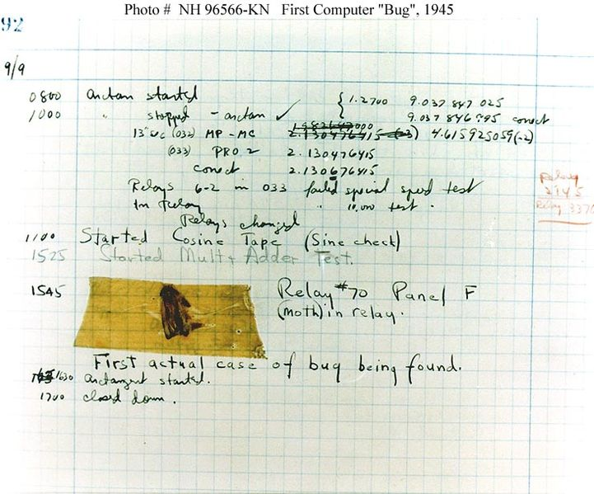
Where does that BUG word come from ?
First Computer “Bug” 1945
n1946, when Hopper was released from active duty, she joined the Harvard Faculty at the Computation Laboratory where she continued her work on the Mark II and Mark III. Operators traced an error in the Mark II to a moth trapped in a relay, coining the term bug. This bug was carefully removed and taped to the log book September 9th 1945. Stemming from the first bug, today we call errors or glitch’s in a program a bug
WW II Radar glitches
1878 Edison

Slide 6
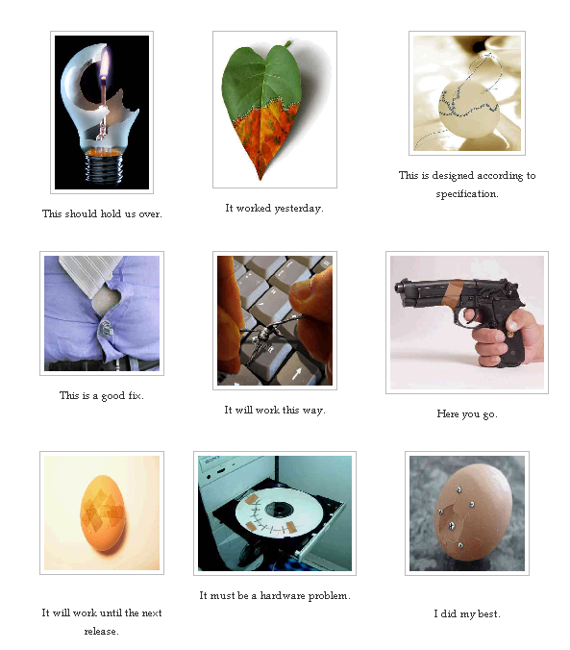
How developers fix defects ?

Slide 7
What is a Software bug ?
The software doesn't do something that the product specification says it should do.
The software does something that the product specification says it shouldn't do.
The software does something that the product specification doesn't mention.
The software doesn't do something that the product specification doesn't mention but should.
The software is difficult to understand, hard to use, slow…

Slide 8
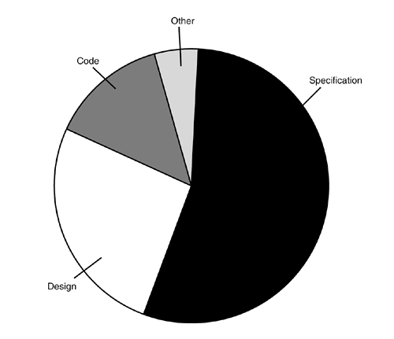
Why do bugs occur ?
Poor Documentation
Schedule pressure
Or just plain dumb mistakes

Slide 9

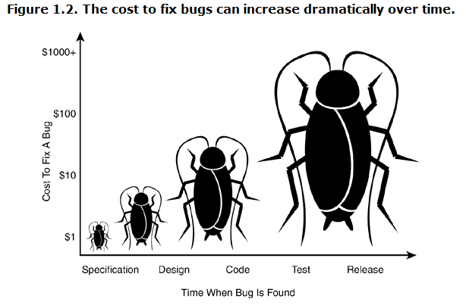
The cost to fix bugs
The cost of Bugs.
Cost of fixing can grow.
Cents to fix, Millions to distribute

